Slide 1
PROJECT 4 · DATA ANALYSIS
Exploratory Data
Analysis
Citi Bike Station-Day Demand · January – February 2026
16,997
Jan–Feb 2026
200+
Station-Day Records
Date Range
Unique Stations

Slide 2
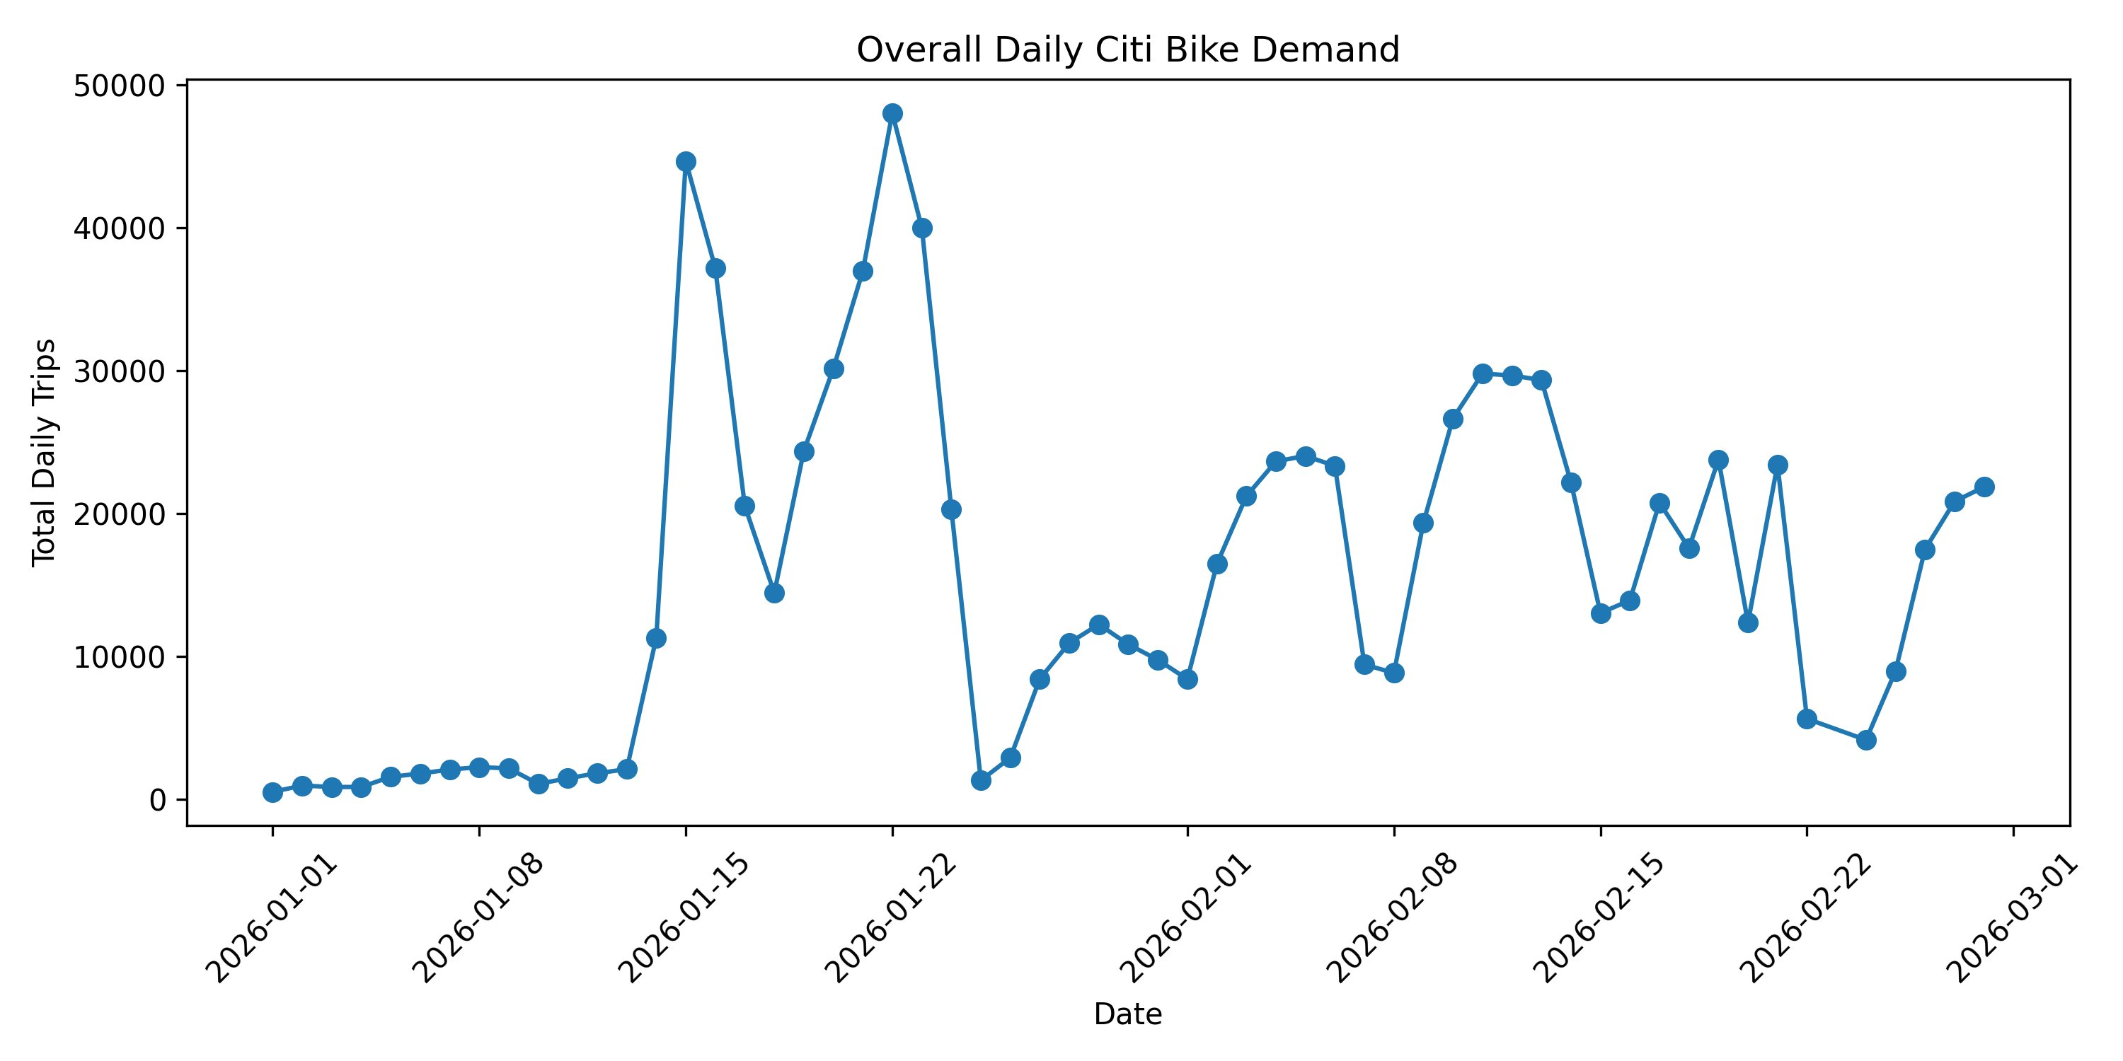
DEMAND OVERVIEW
Overall Daily Citi Bike Demand
💡 Two demand spikes (~45K and ~48K) appear mid-January; volumes stabilize around 15K–30K in February. Early January shows very low demand, likely reflecting data ramp-up.

Slide 3
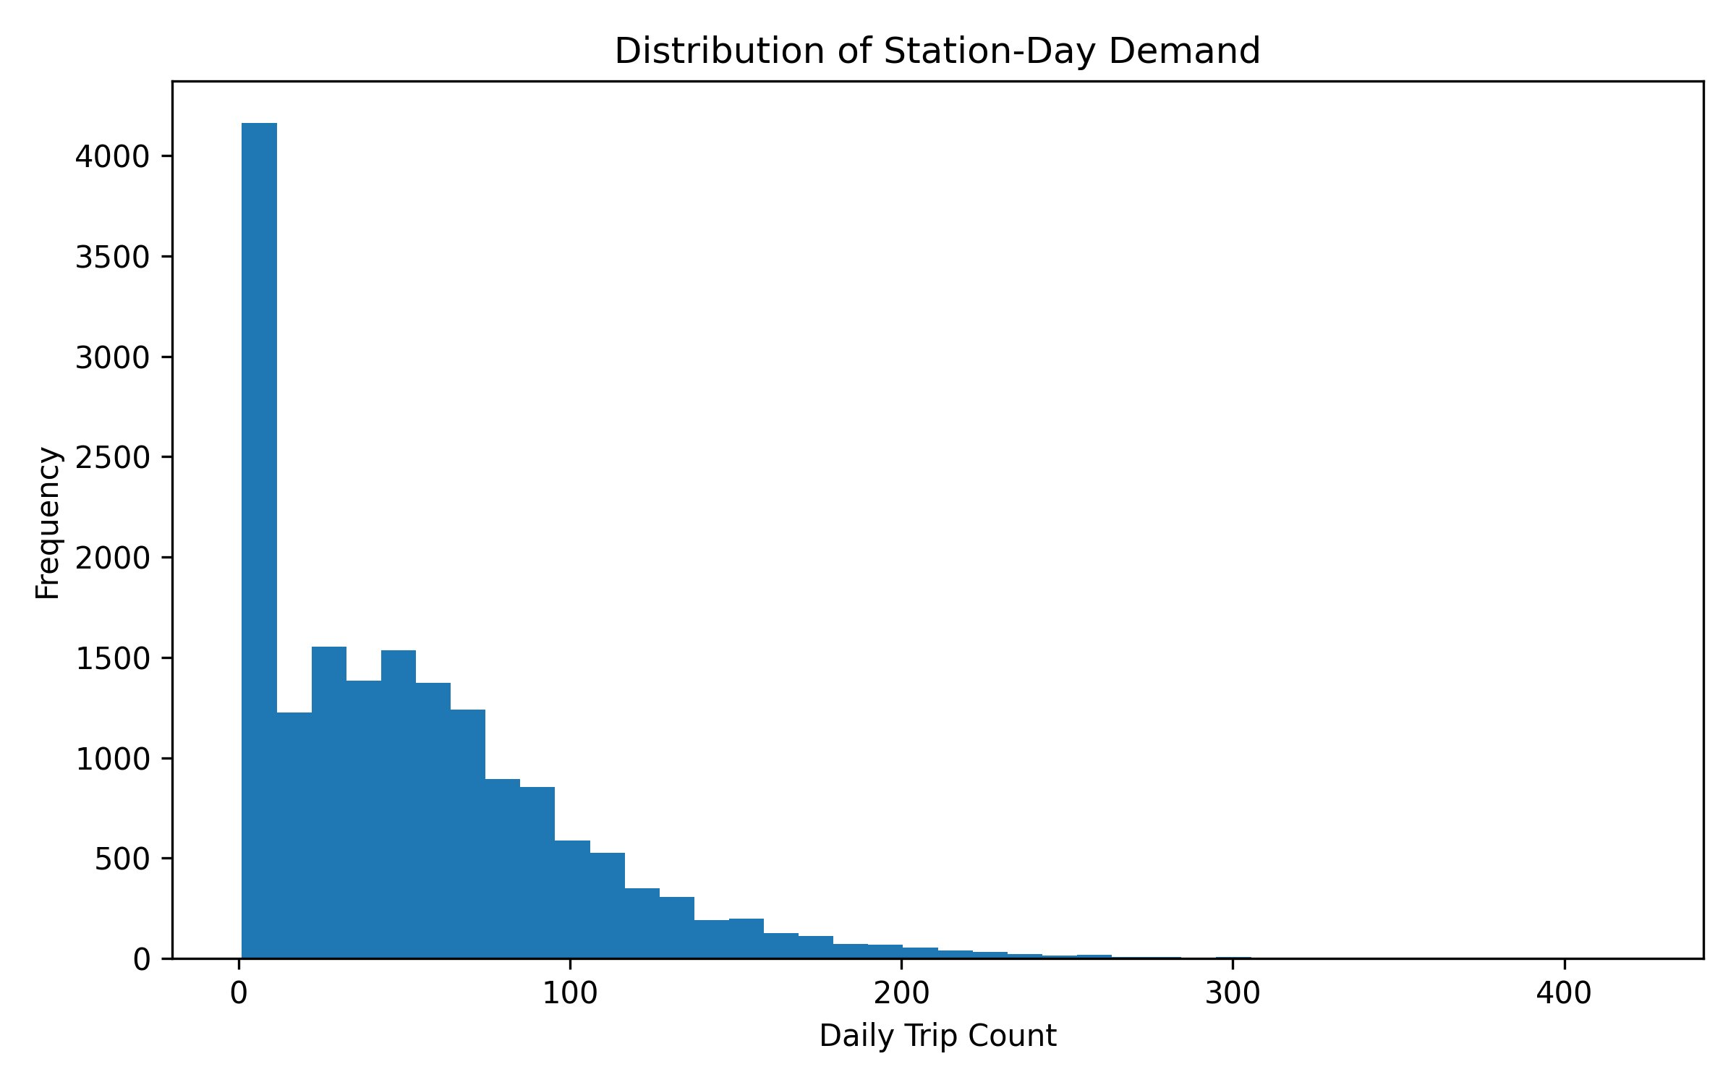
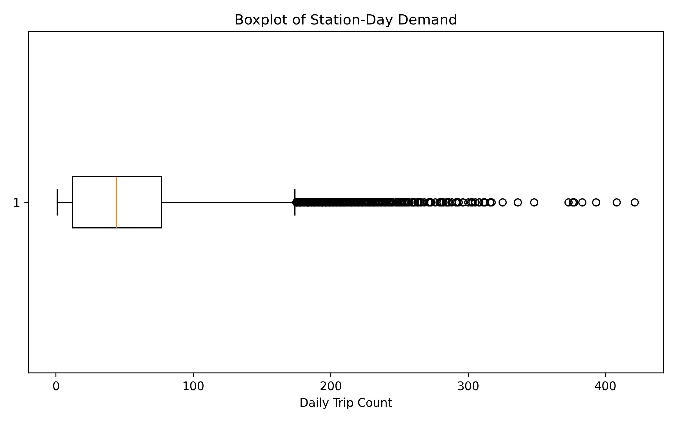
DISTRIBUTION ANALYSIS
Station-Day Demand Distribution
44
53
421
Median Trips/Station
Mean Trips/Station
Max Trips/Station
Distribution is right-skewed — most station-days see fewer than 100 trips, with a small number of high-demand stations pulling the mean above the median.

Slide 4
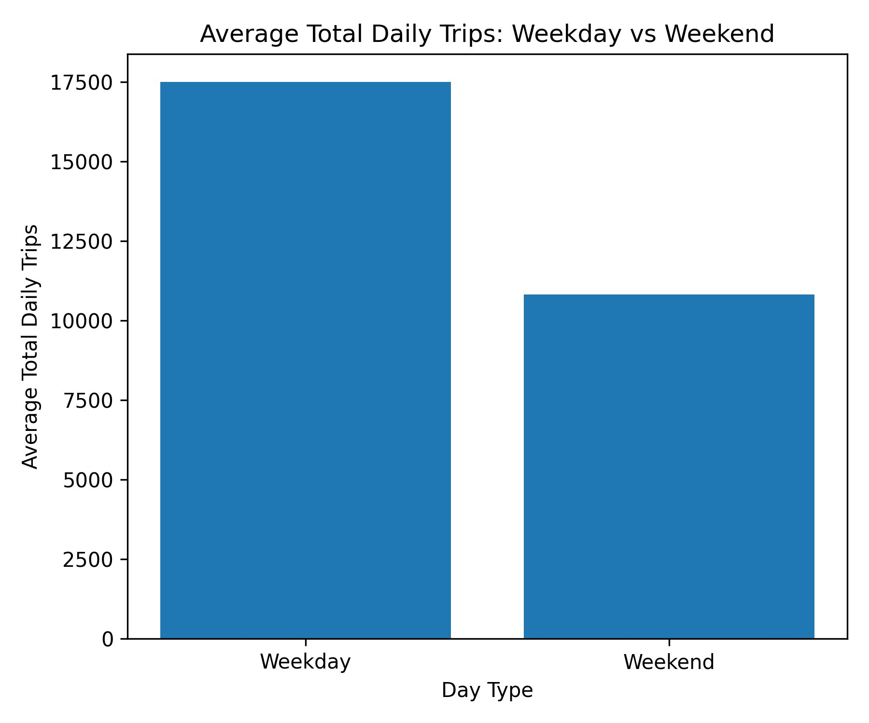
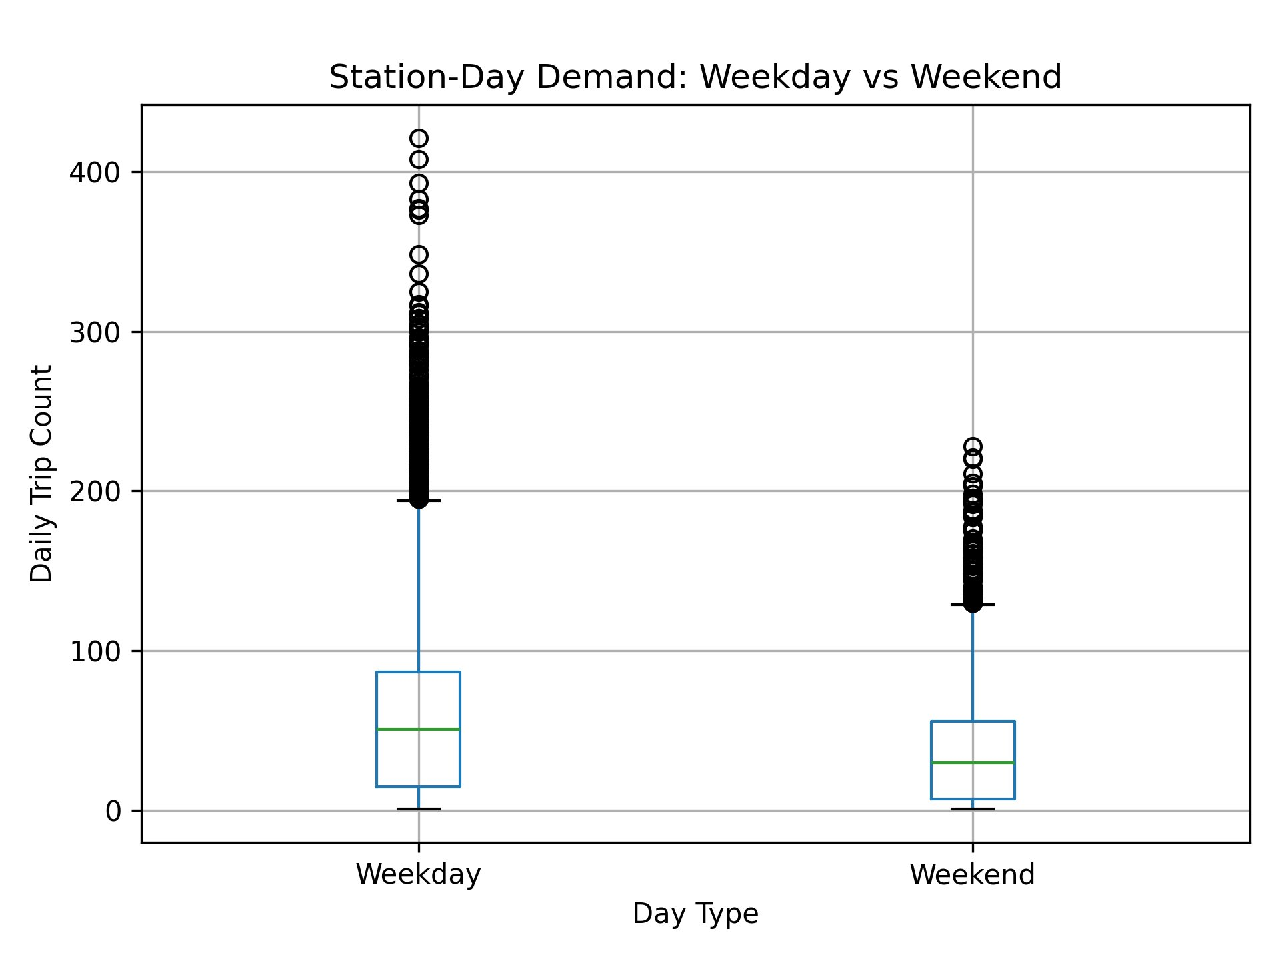
TEMPORAL PATTERNS
Weekday vs. Weekend Demand
~17,500
~11,000
51 vs 30
Weekday Avg · total daily trips
Weekend Avg · total daily trips
Station Median · weekday vs weekend
Weekdays consistently see ~60% more total trips than weekends, with higher medians and greater spread across stations.

Slide 5
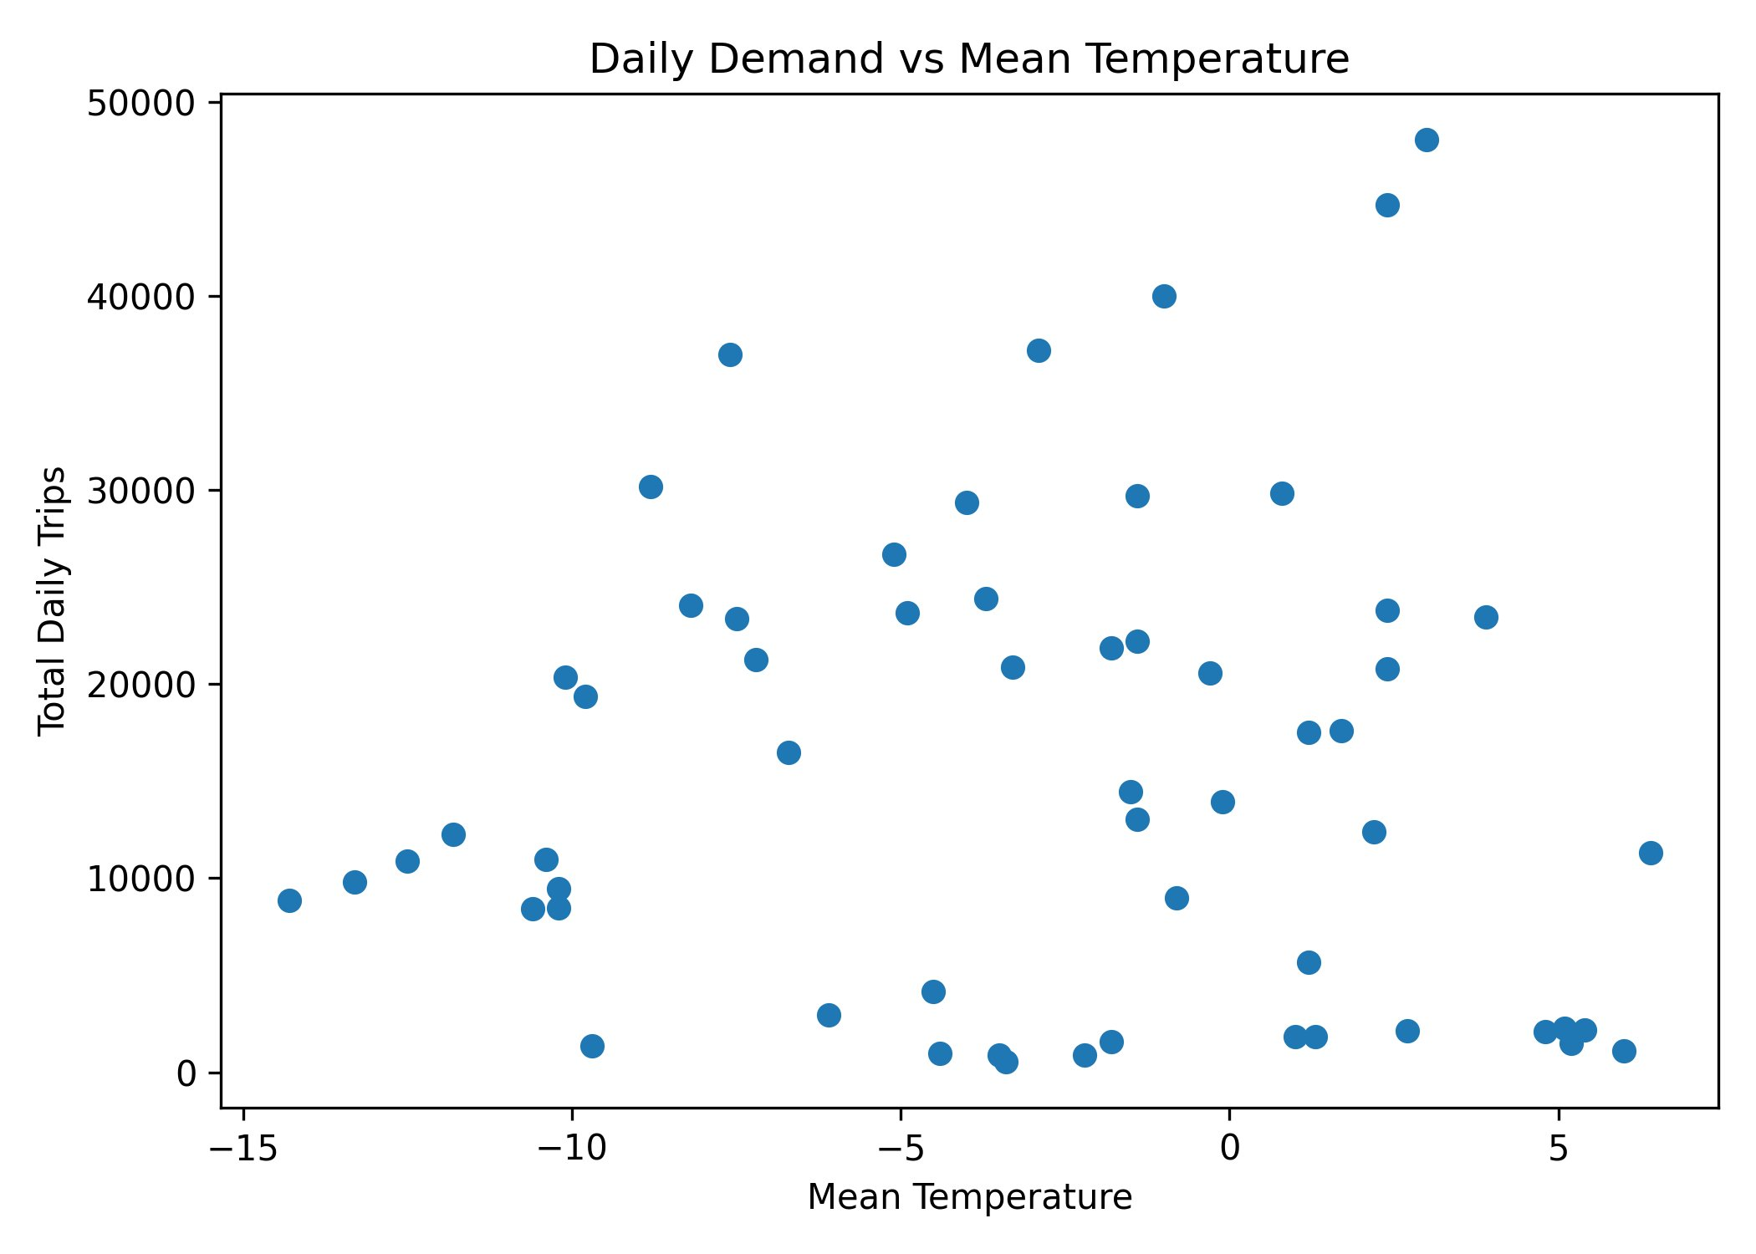
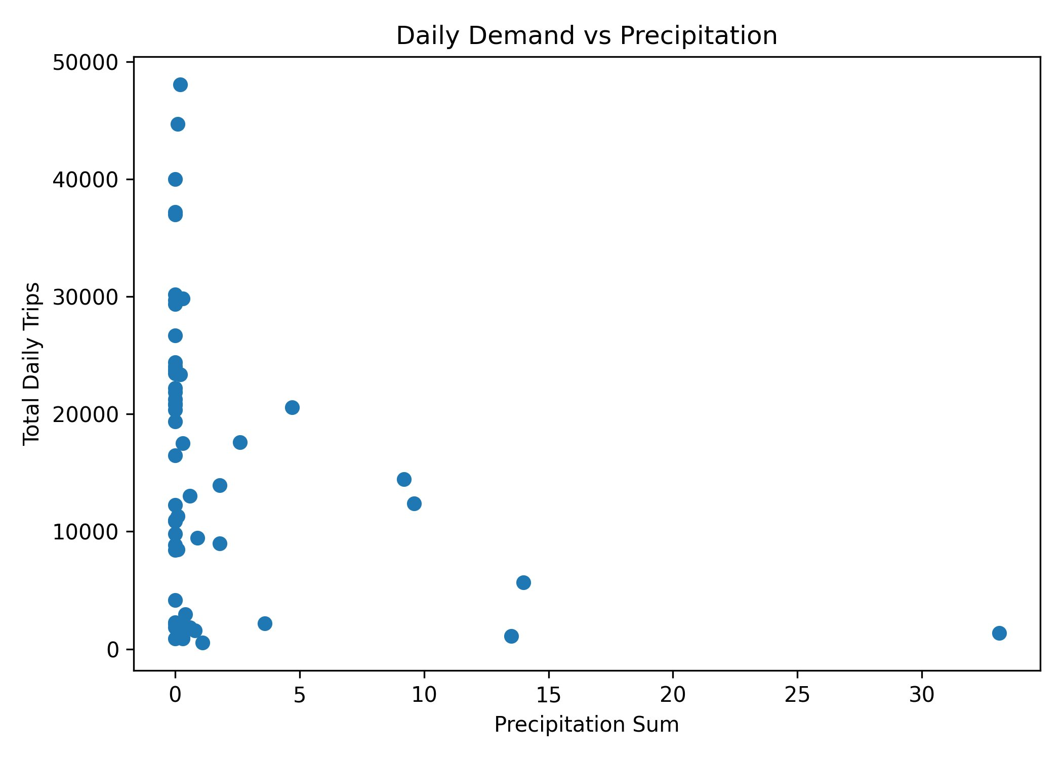
WEATHER IMPACT
Demand vs. Weather Conditions
🌡 Temperature
🌧 Precipitation
💨 Wind Speed
r = −0.02
Weak, non-linear effect
r = −0.26
Moderate negative effect
r = −0.07
Minimal effect
Precipitation shows the clearest negative relationship with demand. Temperature effect is noisy over the winter range observed.

Slide 6
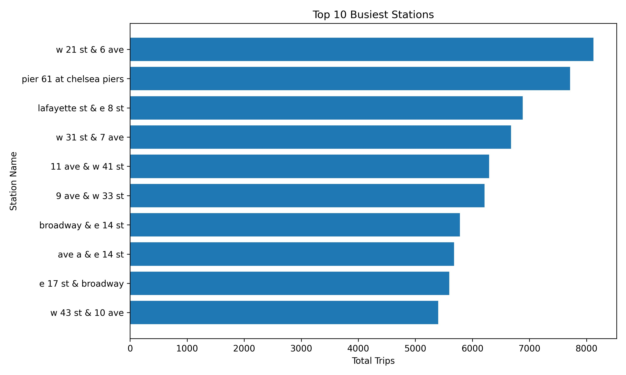
STATION ANALYSIS
Top 10 Busiest Stations
TOP PERFORMERS
#1
W 21 St & 6 Ave
~8,100 trips
#2
Pier 61 at Chelsea Piers
~7,700 trips
#3
Lafayette St & E 8 St
~6,900 trips
Chelsea & Union Square neighborhoods dominate — reflecting commuter + recreational hotspots in Midtown–Lower Manhattan.

Slide 7
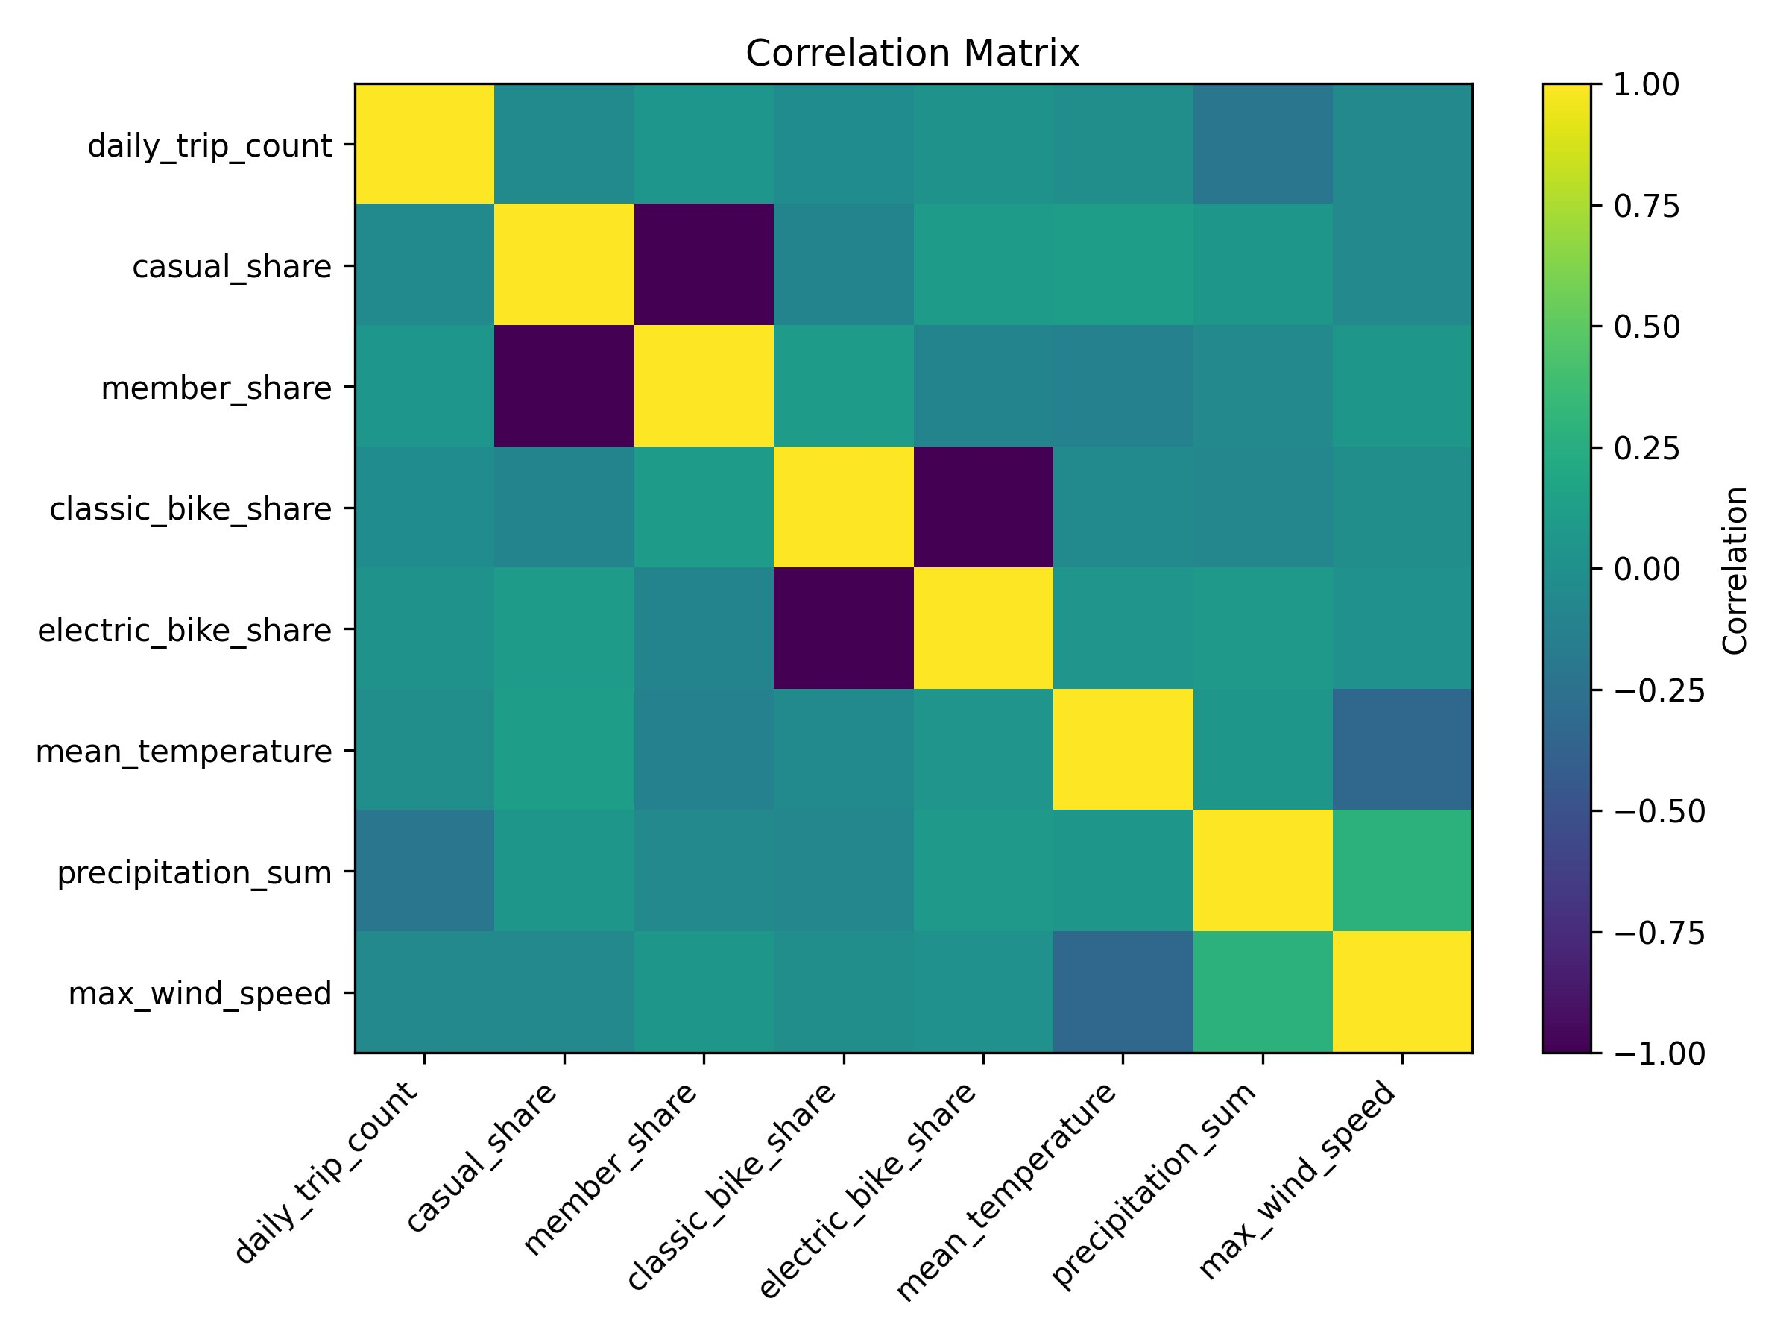
VARIABLE RELATIONSHIPS
Feature Correlation Matrix
Key Findings
casual_share ↔ member_share
Strong negative (r ≈ −1): shares sum to 1 by design
classic ↔ electric bike share
Strong negative (r ≈ −1): same composition constraint
Temperature
Weak positive with demand — winter range limits signal
Precipitation
Moderate negative with daily trips (r ≈ −0.26)
Rider type & bike type
Largely independent of trip count in this period

Slide 8
EDA SUMMARY
Key Takeaways
01
Right-Skewed Demand
02
Strong Weekday Effect
Most station-days record fewer than 100 trips; a small subset of high-traffic stations drives aggregate totals.
Weekdays average ~60% more total trips than weekends. Station-level medians: 51 (weekday) vs 30 (weekend).
03
Precipitation Dampens Demand
04
Concentrated Station Demand
Precipitation has the clearest weather effect (r ≈ −0.26). Temperature signal is noisy over winter ranges.
Top 10 stations (Chelsea, Union Square) account for a disproportionate share of total trips — modeling must account for spatial heterogeneity.

